Slide 1

LAW
MANAGEMENT
SYSTEM

Slide 2

LAW MANAGEMENT SYSTEM
A Law Management System is a database system specifically designed to manage and organize information related to law cases, lawyers, clients, and other entities in the legal field. It helps streamline processes, track case details, manage client information, and improve overall efficiency in the legal practice.
SCOPE OF CASE STUDY
ENTITIES AND THEIR ATTRIBUTES
ER DIAGRAM AND RELATIONSHIPS
TABLES WITH DATA
10 QUERIES
PROCEDURE AND FUNCTION
TRIGGER ANY ONE DML ACTION ON TABLE

Slide 3

SCOPE OF CASE STUDY
The legal system in india works through a combination of traditional law practices and modern technologies. A law management system includes many elements such as Lawyer, Client, Court, Case and Document.
Lawyers are legal professionals who provide legal advice, represent clients in court, and assist with legal issues, contracts, and legal documentation. a lawyer handles many cases. it comprises the Lawyer id, Name, Mobile number, Specialization, Bar license number and Hire date also.
Clients can be individuals or entities (such as businesses) who initiate or defend a lawsuit. clients includes a Unique id, Name, Address ,Mobile number.
Courts are the formal legal systems in which cases are heard and resolved. lawyers present arguments, evidence, and seek legal remedies or justice on behalf of clients in court. court includes the Court id, Name and Address.
There are undoubtedly many types of cases that include criminal, civil, family law, traffic violations cases and so on. each and every cases has its own Case id, Name, Description, Status, Date opened and closed.
Court related document include pleadings, evidences, court orders, summons, transcripts, briefs judgements and legal notices to make every document different from another document has Document id, Name, Type, Declared Date.

Slide 4
ENTITIES AND THEIR ATTRIBUTES
LAWYER: This entity represents lawyers or legal professionals who work within the system.
(LAWYER_ID, FIRST_NAME, LAST_NAME, PHONE, SPECIALIZATION, BAR_LICENSE_NUMBER, HIRE_DATE)
CLIENT: Represents the clients or individuals involved in legal cases.
(CLIENT_ID, FIRST_NAME, LAST_NAME, ADDRESS, MOBILE_NO)
3. CASE: Represents legal cases that lawyers handle.
(CASE_ID, CASE­_NAME, CASE_DESCRIPTION, CASE_STATUS, DATE_OPENED, DATE_CLOSED)
4. COURT: The courts where legal cases are heard.
(COURT_ID, COURT_NAME, ADDRESS)
5. DOCUMENT: Represents documents or records associated with legal cases.
(DOCUMENT_ID, DOCUMENT_NAME, DOCUMENT_TYPE, DATE_DECLARED)

Slide 5
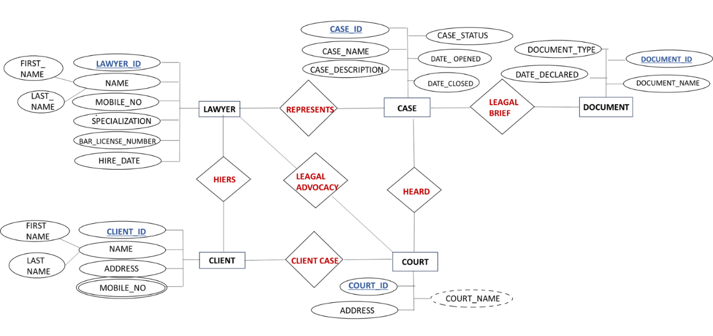
ER DIAGRAM

Slide 6
RELATIONSHIPS
LAWYER-CASES RELATIONSHIPS (One-to-Many): Each lawyer can handle multiple cases.
CLIENT-COURT RELATIONSHIPS (One-to-Many): Each client can be associated with multiple cases, as clients can be involved in various legal matters.
CASE-DOCUMENTS RELATIONSHIPS(One-to-Many): Each case can have multiple legal documents associated with it.
LAWYER-COURT RELATIONSHIPS(Many-to- Many): A lawyer can be associated with multiple courts, and a court can have multiple lawyers associated with it.
LAWYER-CLIENT RELATIONSHIPS (One-to-Many): Each lawyer can represent multiple clients, but each client is typically represented by one lawyer at a time.
CASE-COURT RELATIONSHIP (Many-to-One): Each case is associated with one specific court where legal proceedings related to that case take place.

Slide 7
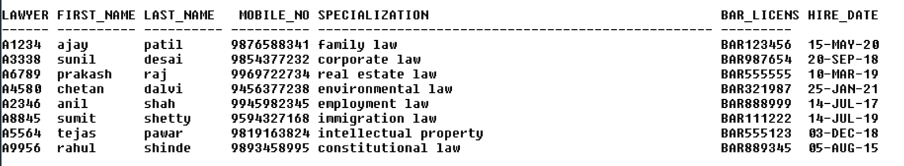
TABLES
LAWYER (Lawyer_id, First_name, Last_name, mobile_no, Specialization, Bar_license_number, Hire_date)

Slide 8
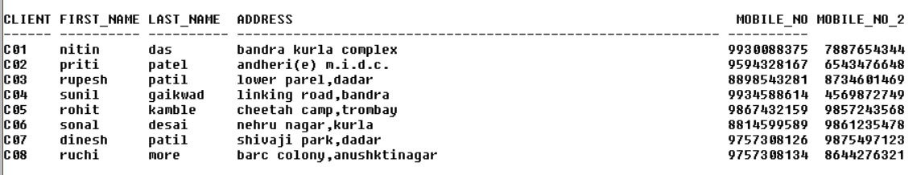
CLIENT (Client_id , First_name , Last_name , Address, Mobile_no )

Slide 9
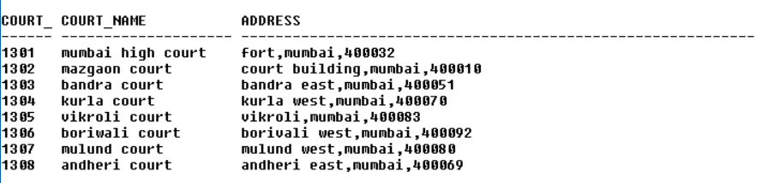
COURT (Court_id, Court_name, Address)

Slide 10
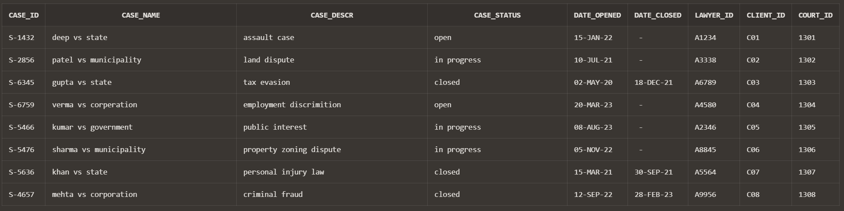
CASE1 (Case_id, Case­_name, Case_description, Case_status, Date_opened, Date_closed, Lawyer_id, Client_id, Court_id)

Slide 11
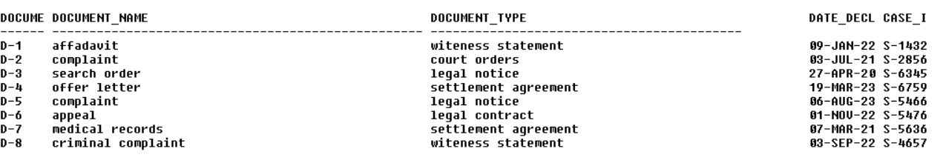
DOCUMENT (Document_id, Document_name, Document_type, Date_declared, Case_id)

Slide 12
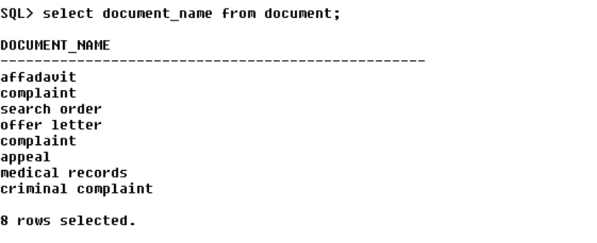
QUERIES
1) Find the names of all Document:
SELECT DOCUMENT_NAME FROM DOCUMENT;

Slide 13
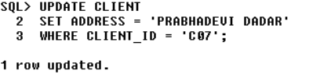
2) Change the address of CLIENT_ID ‘C07’ to ‘PRABHADEVI,DADAR’.
UPDATE CLIENT
SET ADDRESS = ‘PRABHADEVI DADAR’ ;
WHERE CLIENT_ID = C07;

Slide 14
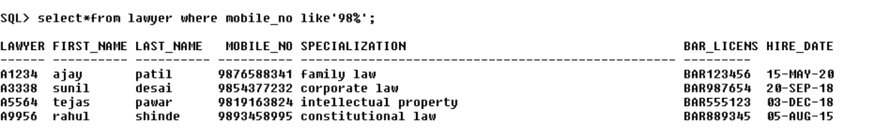
3)SELECT * FROM LAWYER where mobile_no like’98%

Slide 15

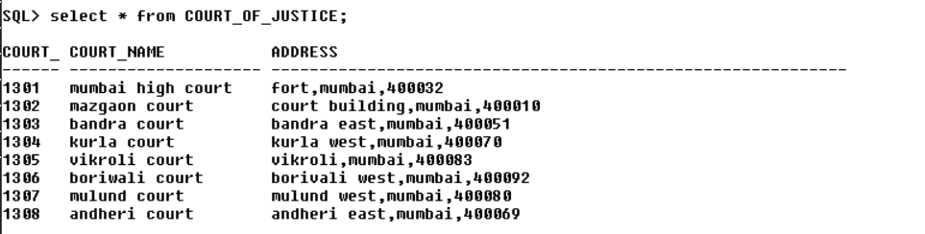
4) Change the name of COURT to COURT_OF_JUSTICE.
ALTER TABLE COURT
RENAME TO COURT_OF_JUSTICE;

Slide 16
5) Find the cases of ‘In Progress’ that started before 2023.
SELECT *FROM CASE1WHERE UPPER(CASE_STATUS) = 'IN PROGRESS' AND DATE_OPENED < TO_DATE('2023-01-01', 'YYYY-MM-DD')

Slide 17
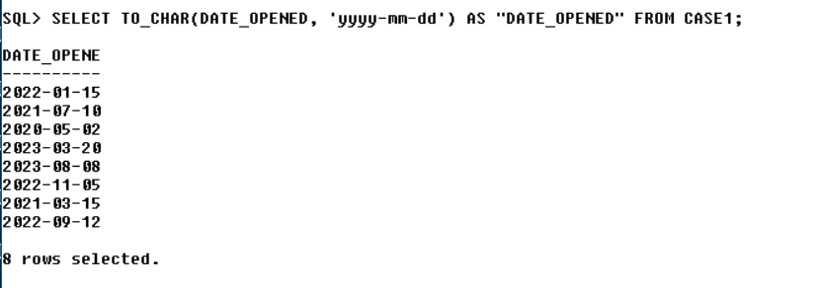
6) List all case started dates in format ‘DD-Month-YY from CASE table.
SELECT TO_CHAR(DATE_OPENED, 'yyyy-mm-dd') AS "DATE_OPENED" FROM CASE1;

Slide 18
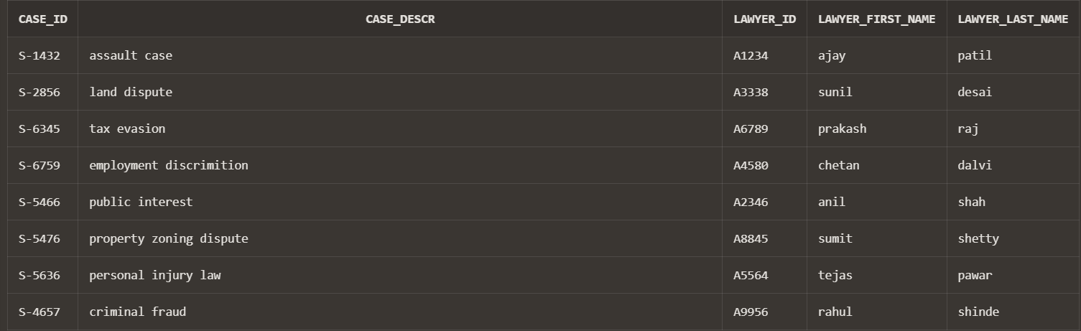
7)Display case id and description with lawyer id and his Name
Select case1.case_id,
case1.case_descr,
lawyer.lawyer_id,
lawyer.first_name AS lawyer_first_name,
lawyer.last_name AS lawyer_last_name
FROM case1
INNER JOIN lawyer
ON lawyer.lawyer_id = case1.lawyer_id;

Slide 19
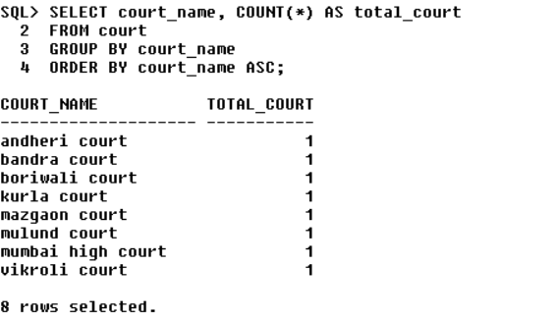
8)Count total number of court with court name in ascending order from court
SELECT court_name, COUNT(*) AS total_court
FROM court
GROUP BY court_name
ORDER BY court_name ASC;

Slide 20
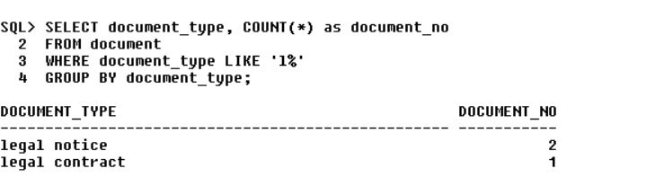
9) Display document type starts with l and how much they are present
SELECT document_type , count(*) as document_no
FROM document
WHERE document_type LIKE ‘l%’
GROUP BY document_type;

Slide 21
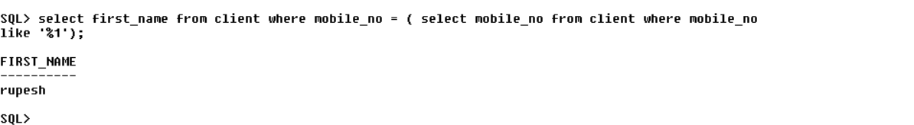
10) Display first name of client where his mobile number ends with 1
select first_name from client where mobile_no = ( select mobile_no from client where mobile_no like '%1');

Slide 22
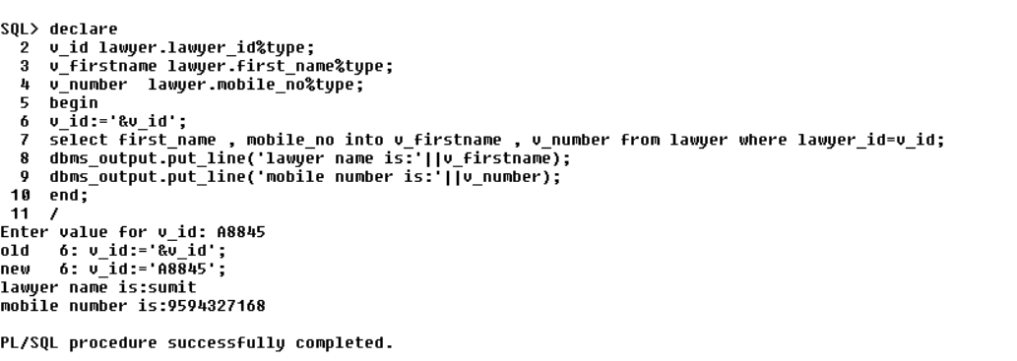
procedure
1) declare
v_id lawyer.lawyer_id%type;
v_firstname lawyer.first_name%type;
v_number lawyer.mobile_no%type;
begin
v_id:='&v_id';
select first_name , mobile_no into v_firstname , v_number from lawyer where lawyer_id=v_id;
dbms_output.put_line('lawyer name is:'||v_firstname);
dbms_output.put_line('mobile number is:'||v_number);
end;
/

Slide 23
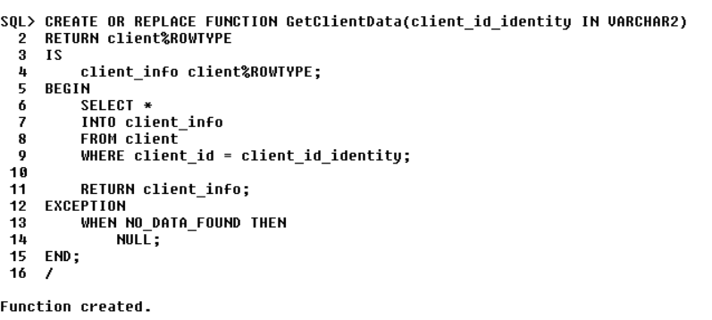
FUNCTION

Slide 24
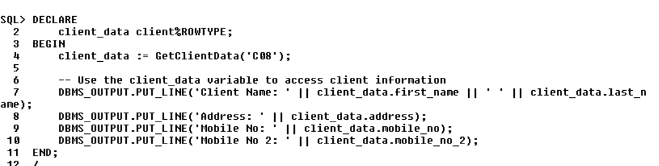
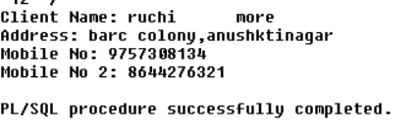
Function call
Output:

Slide 25
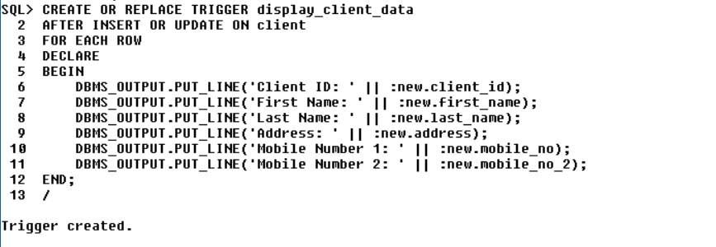

Trigger

